Slide 1
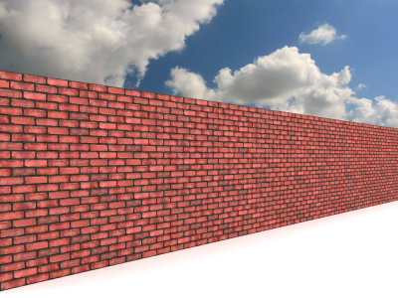

Masonry and Mortar Basics
Masonry and Mortar Basics – 05.21.2018
FOR INTERNAL USE ONLY

Slide 2
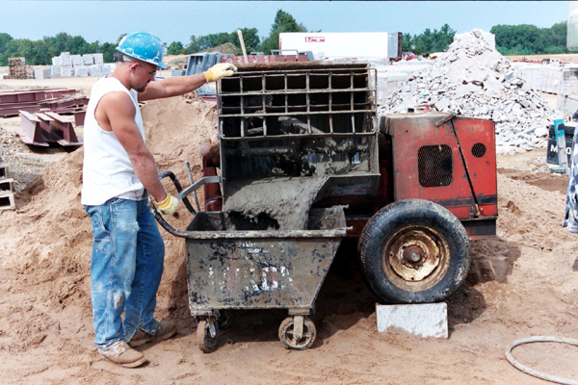
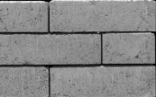
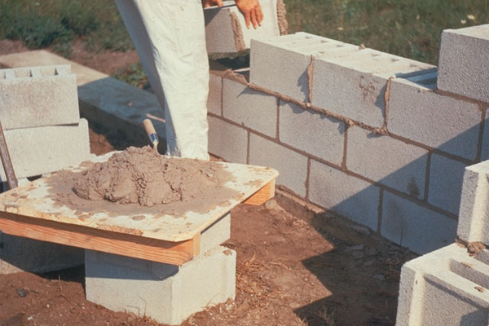
Mortar Basics
What is Masonry Mortar?
A mixture of cementitious materials, aggregate and water (possibly admixtures) used with masonry units to construct masonry assemblies. Mortar holds units apart and together.
4 Critical Factors for good masonry wall performance:
  Wall Design
  Masonry Units
  Mortar
  Workmanship
Masonry and Mortar Basics – 05.21.2018
Notes:
Mortar holds units apart and together.

Slide 3
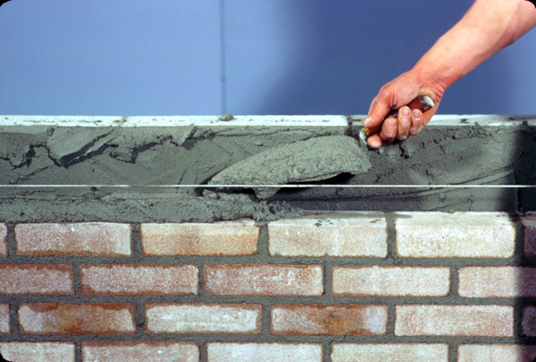
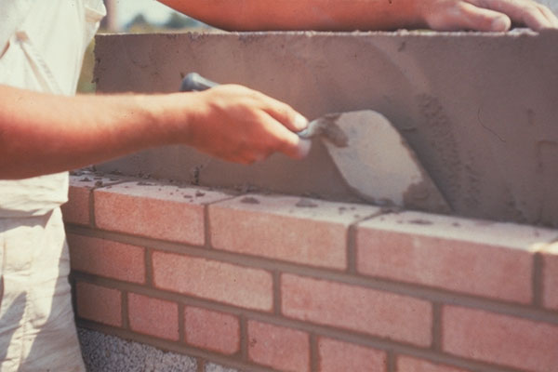
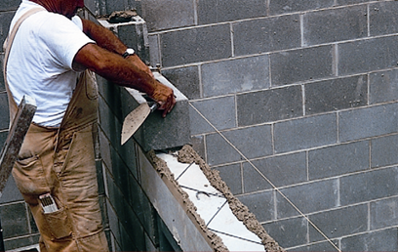
Mortar Basics
Purpose of Masonry Mortars
Bonds units together and holds them apart.
Seals joints against air/water penetration.
Compensates for unit size variations.
Bonds with joint reinforcement like metal ties so that they perform integrally with the wall.
Masonry and Mortar Basics – 05.21.2018
Notes:
These uses include: bonding units together, sealing joints, compensating for unit size variations, bonding of joint reinforcements.
Please note, masonry mortar is not a grout. Please reference ASTM C 486 for grout specifications.

Slide 4
Mortar Basics
Mortar Types in ASTM C270
Type M, “Strongest” Mortar
  Minimum Compressive Strength @ 28 days = 2,500 psi
  Generally used in below grade masonry construction
Type S, “Stronger” Mortar
  Minimum Compressive Strength @ 28 days = 1,800 psi
  Generally used in commercial and residential construction
Type N, “General Purpose” Mortar
  Minimum Compressive Strength @ 28 days = 750 psi
  Generally used in non-load bearing residential and light commercial construction.
Portland Cement / Lime
Type N | Type S | Type M
Masonry Cement
Type N | Type S | Type M
Mortar Cement
Type N | Type S | Type M
Masonry and Mortar Basics – 05.21.2018
4

Slide 5
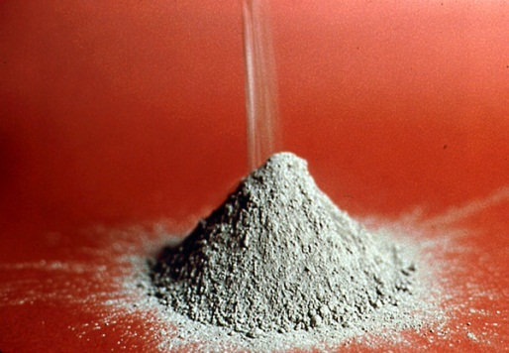
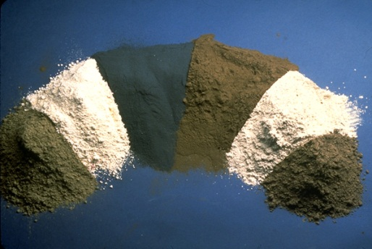
Mortar Basics
Cementitious Materials used in Mortar
Portland Cement (ASTM C150)
Hydraulic Cement (ASTM C1157)
Blended Hydraulic Cement (ASTM C595)
Hydrated Lime (ASTM C207)
Masonry Cement (ASTM C91)
Mortar Cement (ASTM C1329)
Masonry and Mortar Basics – 05.21.2018

Slide 6
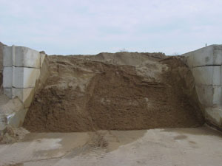
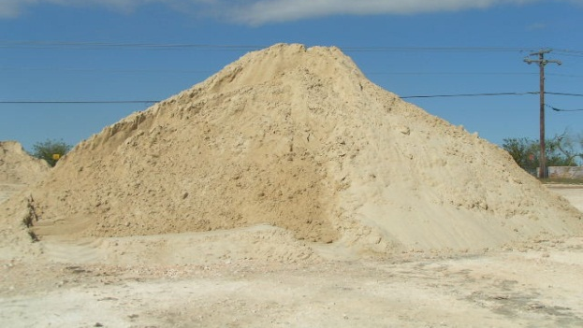
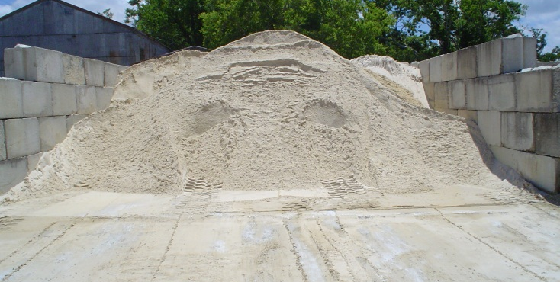
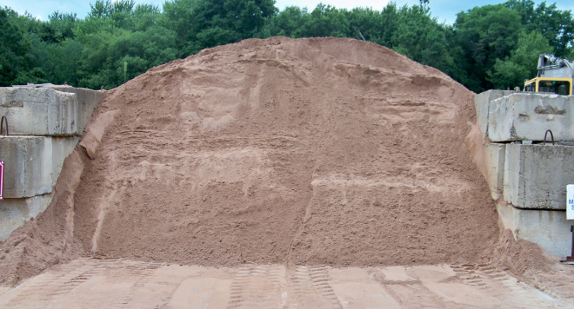
Mortar Basics
Aggregate – Mason’s Sand
Sand makes up approximately 75% of a mortar’s volume; so, the quality of sand greatly effects all the plastic and hardened mortar properties, like work-ability, board life, compressive strength, drying shrinkage and color.
Should meet ASTM C144 “Standard Specification for Aggregate for Masonry Mortar”.
Masonry and Mortar Basics – 05.21.2018

Slide 7
Mortar Basics
ASTM C144 Specification Requirements:
 | Gradation Specified, Percent Passing
 | ASTM C144*
Sieve Size No. | Natural Sand | Manufactured Sand
4 8 16 30 50 100 200 | 100 95 to 100 70 to 100 40 to 75 10 to 35 2 to 15 — | 100 95 to 100 70 to 100 40 to 75 20 to 40 10 to 25 0 to 10
*Additional requirements: Not more than 50% shall be retained between any two sieve sizes nor more than 25% between No. 50 and No. 100 sieve sizes. Where an aggregate fails to meet the gradation limit specified, it may be used if the masonry mortar will comply with the property specification of ASTM C270 (Table 2-2).
Other Requirements:
Relatively free of deleterious materials
Relatively free of organic impurities
Fineness Modulus cannot vary by more than 0.20
Masonry and Mortar Basics – 05.21.2018

Slide 8
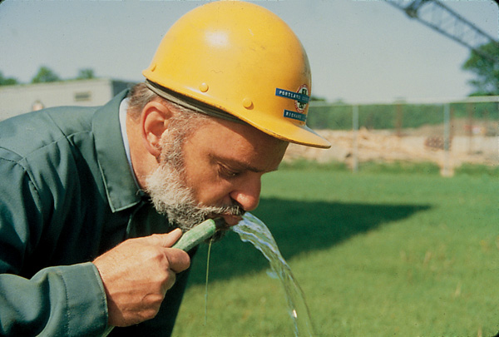
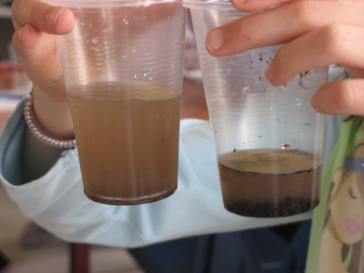
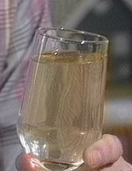
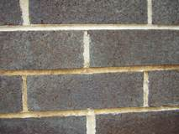
Mortar Basics
Water
Required for chemical hydration of the cementitious material.
Should be clean and potable.
IRON
Do not use
dirty water
Masonry and Mortar Basics – 05.21.2018

Slide 9
ASTM Standards and Specifications
ASTM C270
“Standard Specification for Mortar for Unit Masonry”
Two Specifications*:
  Proportion Specification: prescribes the parts by volume of each ingredient. Normally used in most residential and commercial construction.
  Property Specification: conformance to these requirements is established by testing the mortar in a laboratory. The laboratory determined combination of materials is then used for construction in the field.
*When neither specification is specified – the proportion specification governs.
Masonry and Mortar Basics – 05.21.2018

Slide 10
ASTM Standards and Specifications
Proportion Specification - ASTM C270
 |  | Proportions by Volume (Cementitious Materials)
 |  | Portland Cement or Blended Cement | Masonry Cement |  |  | Mortar Cement |  |  | Hydrated Lime or Lime Putty | Aggregate Ratio (Measured in Damp, Loose Conditions)
 |  |  | M | S | N | M | S | N
Cement - Lime | M | 1 | — | — | — | — | — | — | ¼ | Not less than 2¼ and not more than 3 times the sum of the separate volumes of cementitious materials
 | S | 1 | — | — | — | — | — | — | Over ¼ to ½
 | N | 1 | — | — | — | — | — | — | Over ½ to 1¼
 | O | 1 | — | — | — | — | — | — | Over 1¼ to 2½
Masonry Cement | M | 1 | — | — | 1 | — | — | — | —
 | M | — | 1 | — | — | — | — | — | —
 | S | ½ | — | — | 1 | — | — | — | —
 | S | — | — | 1 | — | — | — | — | —
 | N | — | — | — | 1 | — | — | — | —
 | O | — | — | — | 1 | — | — | — | —
Mortar Cement | M | 1 | — | — | — | — | — | 1 | —
 | M | — | — | — | — | 1 | — | — | —
 | S | ½ | — | — | — | — | — | 1 | —
 | S | — | — | — | — | — | 1 | — | —
 | N | — | — | — | — | — | — | 1 | —
Masonry and Mortar Basics – 05.21.2018
10
Notes:
This table illustrates the proportion by volume of cementitious materials and aggregates used to produce all mortar types as documented in ASTM C 270.

Slide 11
ASTM Standards and Specifications
Proportion Specification - ASTM C270
 |  | Average Compressive Strength at 28 Days: Minimum PSI | Water Retention: Minimum % | Air Content: Maximum % | Aggregate Ratio (Measured in Damp, Loose Conditions)
Cement -Lime or Mortar Cement | M | 2,500 | 75 | 12 | Not less than 2¼ and not more than 3½ times the sum of the separate volumes of cementitious materials
 | S | 1,800 | 75 | 12
 | N | 750 | 75 | 14
 | O | 350 | 75 | 14
Masonry Cement | M | 2,500 | 75 | 18
 | S | 1,800 | 75 | 18
 | N | 750 | 75 | 18
 | O | 350 | 75 | 18
Masonry and Mortar Basics – 05.21.2018
11
Notes:
This table illustrates the proportion by volume of cementitious materials and aggregates used to produce all mortar types as documented in ASTM C 270.

Slide 12
ASTM Standards and Specifications
Comments on mortar strength...
ASTM C270
“Standard Specification for Mortar for Unit Masonry”
  Mortar strength – “A mortar type of known higher strength shall not be indiscriminately substituted where a mortar of anticipated lower strength is specified.”
  Mortar strength should not exceed the strength of the masonry units.
    If cracking were to occur, it is more likely to happen in the mortar joint which is easier to repair.
  Mortar strength in-situ may be higher than laboratory testing, based on the dimension of the mortar joint versus the laboratory test cube.
Masonry and Mortar Basics – 05.21.2018

Slide 13
ASTM Standards and Specifications
Additional comments on mortar strength and field testing of mortar...
ASTM C270 “Standard Specification for Mortar for Unit Masonry”
  Section 3.3 “The compressive strength values resulting from field tested mortars do not represent the compressive strength of mortar as tested in the laboratory nor that of mortar in the wall.”
ASTM C780 “Standard Test Method for Preconstruction and Construction Evaluation of Mortars for Plain and Reinforced Unit Masonry”
  Section 1.4 “The test results obtained under this method are not required to meet the minimum compressive values in accordance with the property specification in C270.”
Masonry and Mortar Basics – 05.21.2018
FOR INTERNAL USE ONLY
13

Slide 14
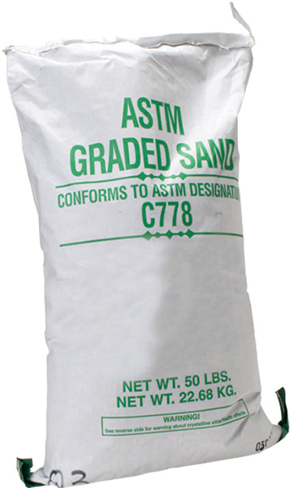
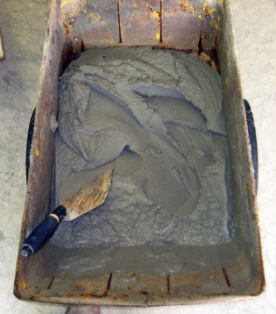
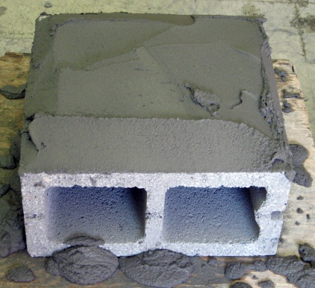
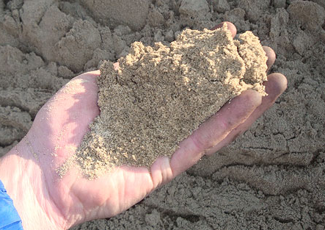
ASTM Standards and Specifications
Compressive Strength Experiment with a Type S Masonry Cement
ASTM C91, Laboratory Cubes w/ a graded silica sand at a flow of 110 + 5*.
3330 psi
ASTM C780, Field Cubes** tested right out of the mixer.
1800 psi
ASTM C780, Field Cubes** tested after resting on the surface of a masonry unit for ~15 min.
2230 psi
ASTM C270, Laboratory Cubes w/ a field mason sand at a flow of 110 + 5*.
2490 psi
*Note: Flow of 110 is very stiff!
**Note: C780 also allows for cylinders
Masonry and Mortar Basics – 05.21.2018

Slide 15
Good Construction Practice
Masonry and Mortar Basics – 05.21.2018
FOR INTERNAL USE ONLY
15

Slide 16
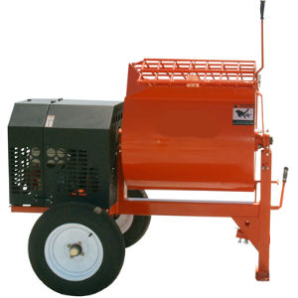
Good Construction Practice
Basics of Mortar Mixing
Mortar should be machine mixed for a minimum of 3 minutes and a maximum of 5 minutes.
  If mortar is mixed for less than 3 minutes or greater than 5 minutes, the mortar may:
    Be non-uniform
    Have poor workability
    Have low water retention
    Have less than optimal air content
    Have lower strength and/or durable properties
Charge mixer to full capacity for optimal mixing action.
Empty full contents of mixer so as to not impair subsequent batches.
Masonry and Mortar Basics – 05.21.2018

Slide 17
Good Construction Practice
Maintaining Mortar Consistency on the Job
Fresh mortar should be prepared at the rate its needed.
Control moisture loss on dry windy days by:
  Keeping mortar boards moist.
  Covering mortar tubs or wheelbarrows with plastic.
  Keep mortar materials cool.
Try to keep the same person in charge of mixing all the mortar.
Keep mixing area clean and avoid material contamination.
Keep sand pile covered to better control material moisture.
Use a cubic foot sand box, or other uniform measuring container…
Masonry and Mortar Basics – 05.21.2018

Slide 18
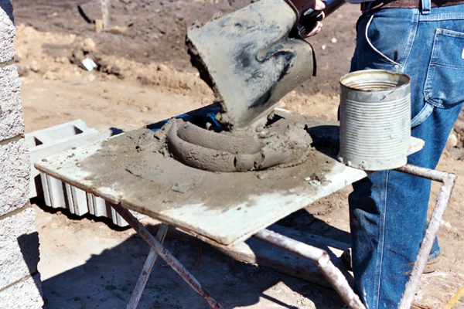
Good Construction Practice
Restoring Mortar Consistency on the Job
A stiff non-workable mortar often times can be “restored” by adding a small amount water on the mortar board, this process is commonly referred to as re-tempering.
Mortar older than 2 ½ hours should not be re- tempered.
Thoroughly remix mortar after adding water.
Small water additions will increase the mortar w/c ratio and slightly reduce mortar strength.
Building walls with a workable, plastic mortar (instead of a dry, stiff mortar) will:
  Have better bond strength between the mortar and masonry units.
  Be more resistant to water penetration.
  And will likely not prematurely dry out after being laid in the wall.
Masonry and Mortar Basics – 05.21.2018

Slide 19
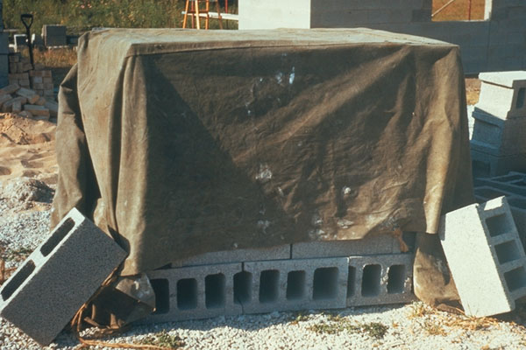
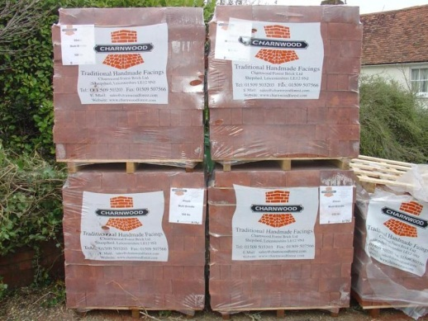
Good Construction Practice
Preparing Masonry Units for Installation
Concrete Masonry Units
  Should be dry at time of wall construction.
  Should never be wetted immediately before or during wall construction.
    Units shrink when they dry – could cause drying shrinkage cracks in the masonry wall
Clay Masonry Units
  Protect at job site to prevent uneven wetting and accumulation of dirt.
  It may be desirable to wet high IRA (initial rate of absorption) units prior to laying them in the wall.
Masonry and Mortar Basics – 05.21.2018

Slide 20
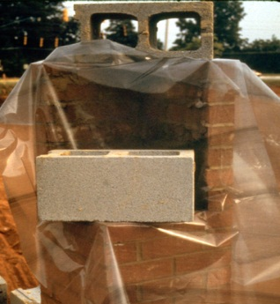
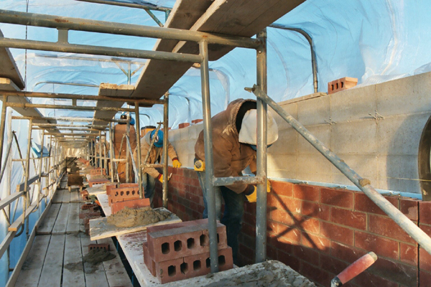
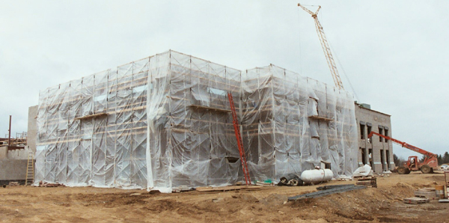
Good Construction Practice
Jobsite Protection
Cover new construction to protect the masonry assembly from the elements and promote better curing of the mortar.
Cure mortar a minimum of 7 days before cleaning.
Take special precautions in either “cold” or “hot” weather.
  Pre-heat and/or cool mortar materials.
  Protect masonry units from extreme cold or hot weather, i.e. ice or storage in direct sunlight…
  Protect new construction from extreme temperatures, i.e. freezing or drying out due to heat…
Masonry and Mortar Basics – 05.21.2018
20

Slide 21
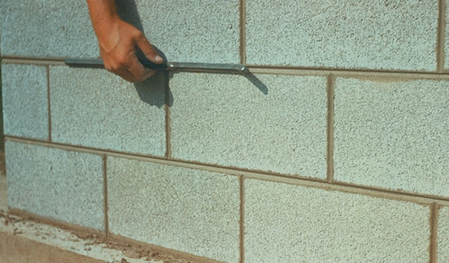
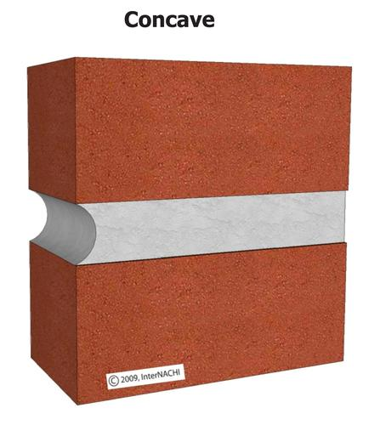
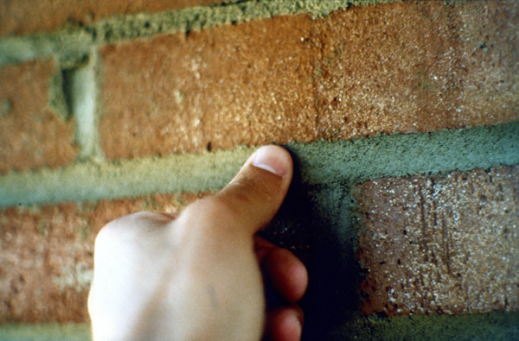
Good Construction Practice
Tooling Mortar Joints
Tooling a mortar joint creates a neat finished appearance and helps to make the joint “water tight”.
Different joints offer a wide range of architectural looks or appearance in a finished wall.
Concave or Vee joints are best at resisting water penetration.
Timing is critical for a uniform finish and appearance.
Generally, tooling can be done when mortar is thumb-print hard.
Do not tool at different time intervals after placement as this can cause inconsistent color and texture.
Masonry and Mortar Basics – 05.21.2018
21

Slide 22
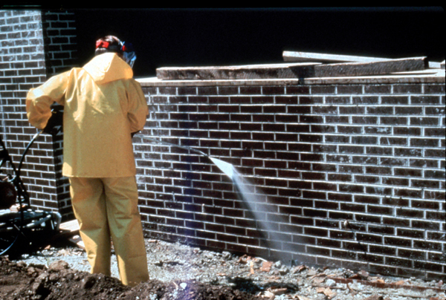
Good Construction Practice
Cleaning Finished Masonry
Cure assembly 7 days before cleaning
Protect other parts of the structure
Use appropriate cleaning solution for masonry unit and mortar.
Avoid using acids.
Pre-wet wall, apply cleaner and completely rinse after cleaning.
Clean top down in small manageable sections, don’t over reach!
Use plenty of water, 6-8 gallons per minute and limit water pressure to 400 to 1000 psi.
Test section is always a good idea.
Masonry and Mortar Basics – 05.21.2018
22

Slide 23

Questions & Comments
Masonry and Mortar Basics – 05.21.2018

